Slide 1
SPQR spacetime model fit metrics

Slide 2
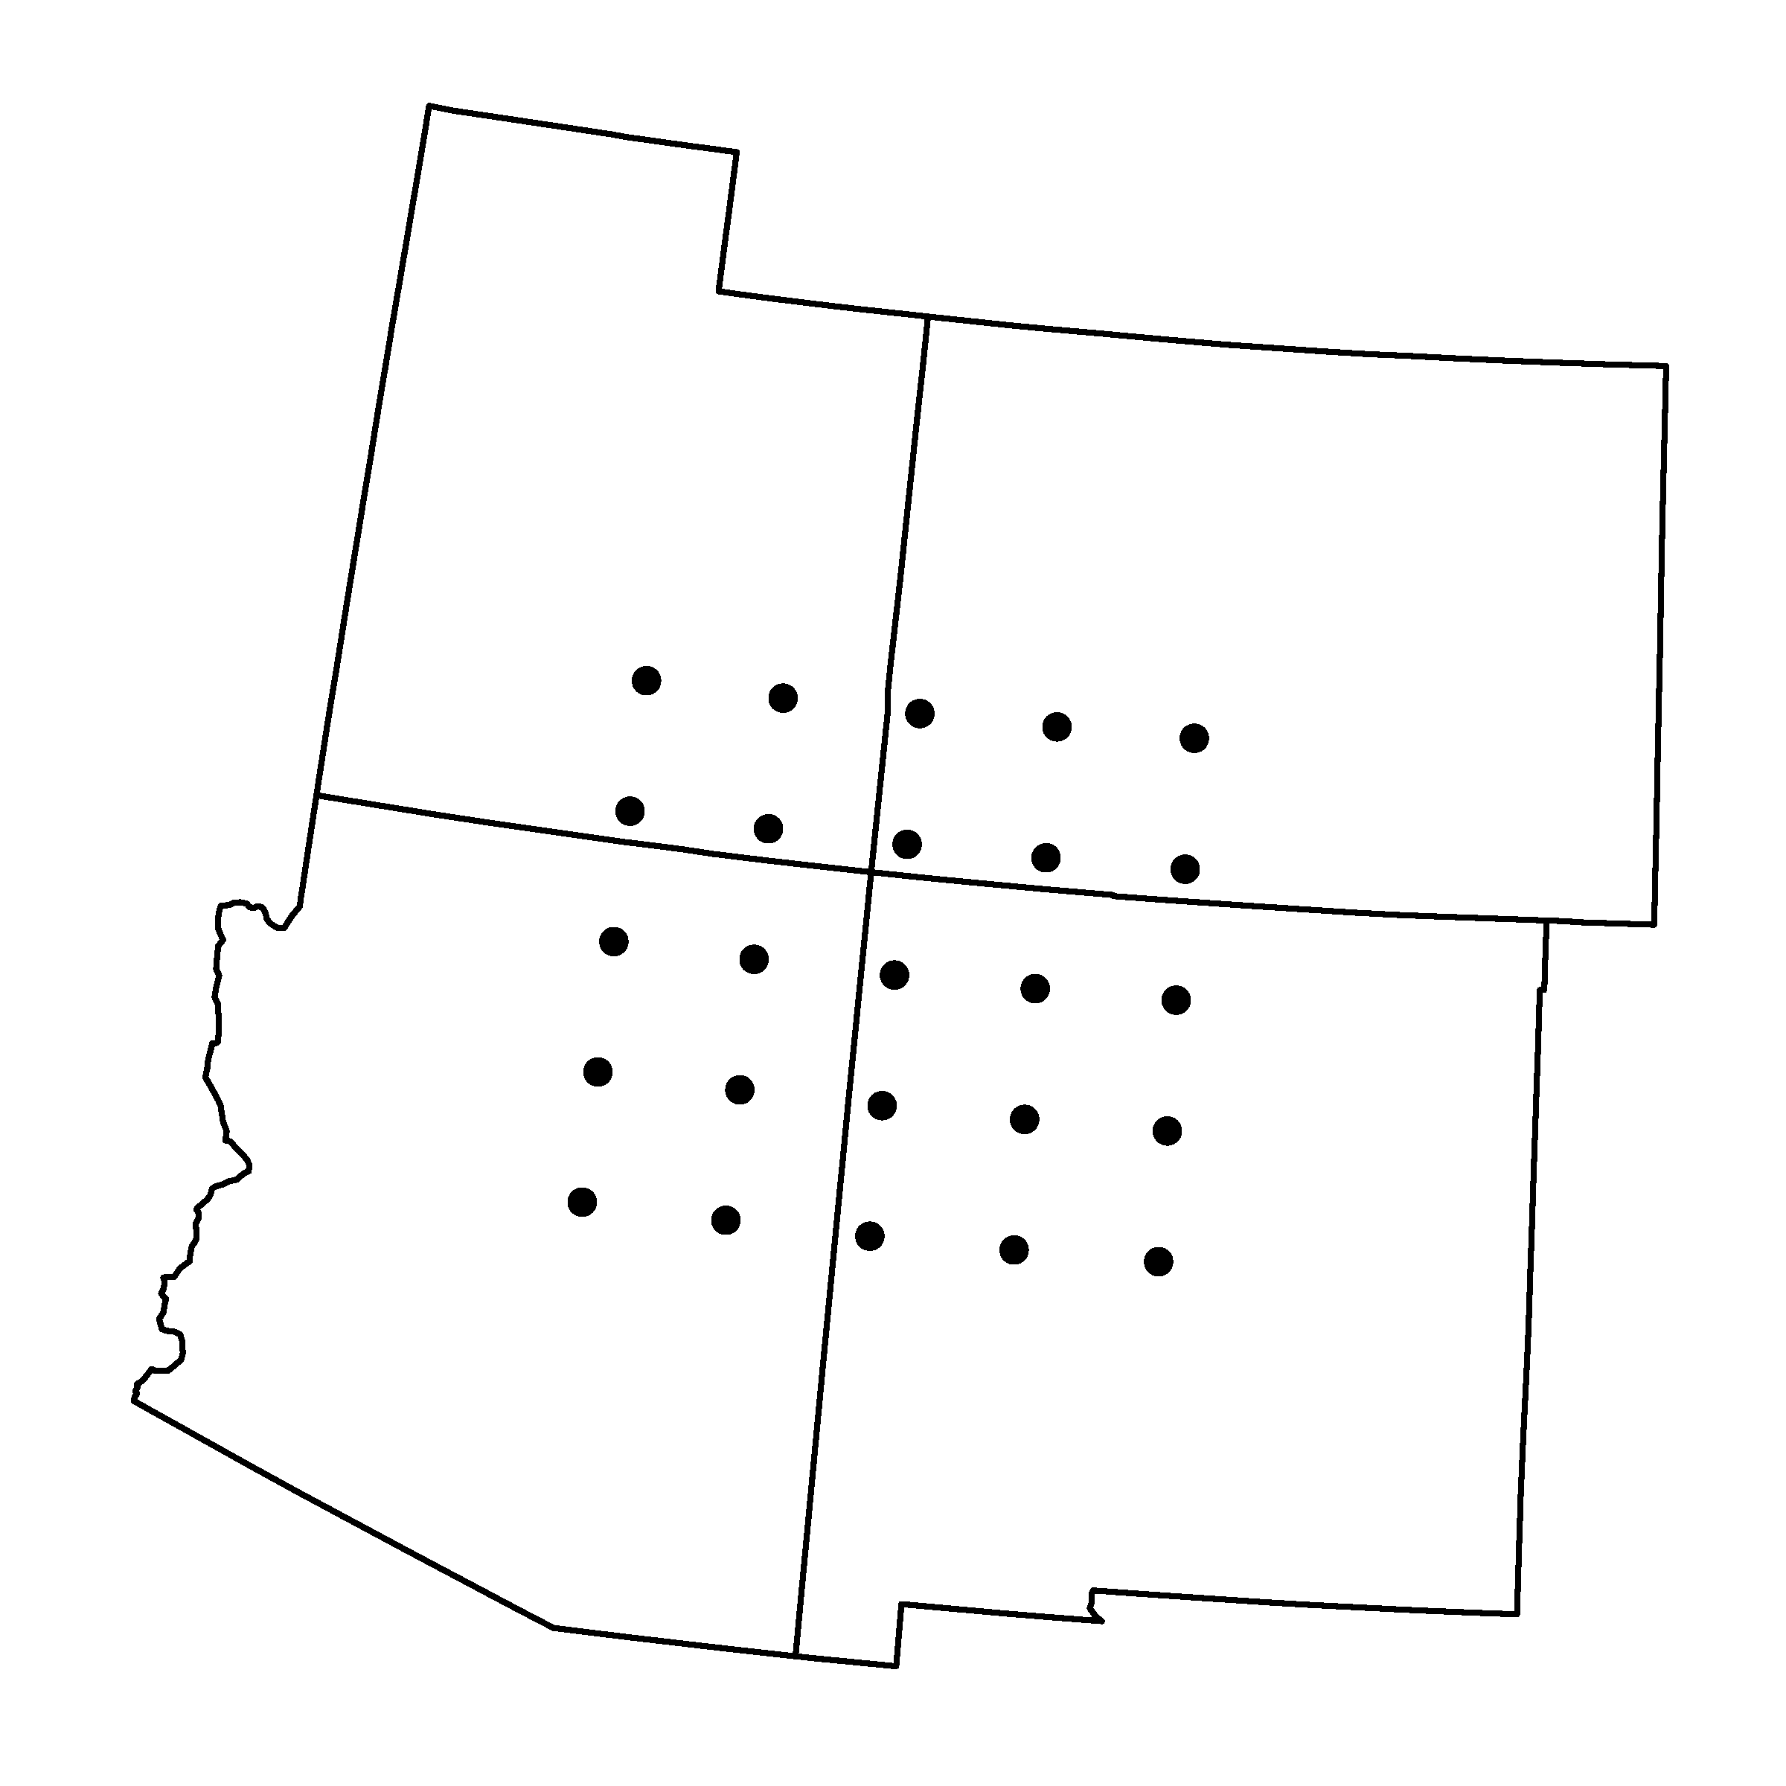
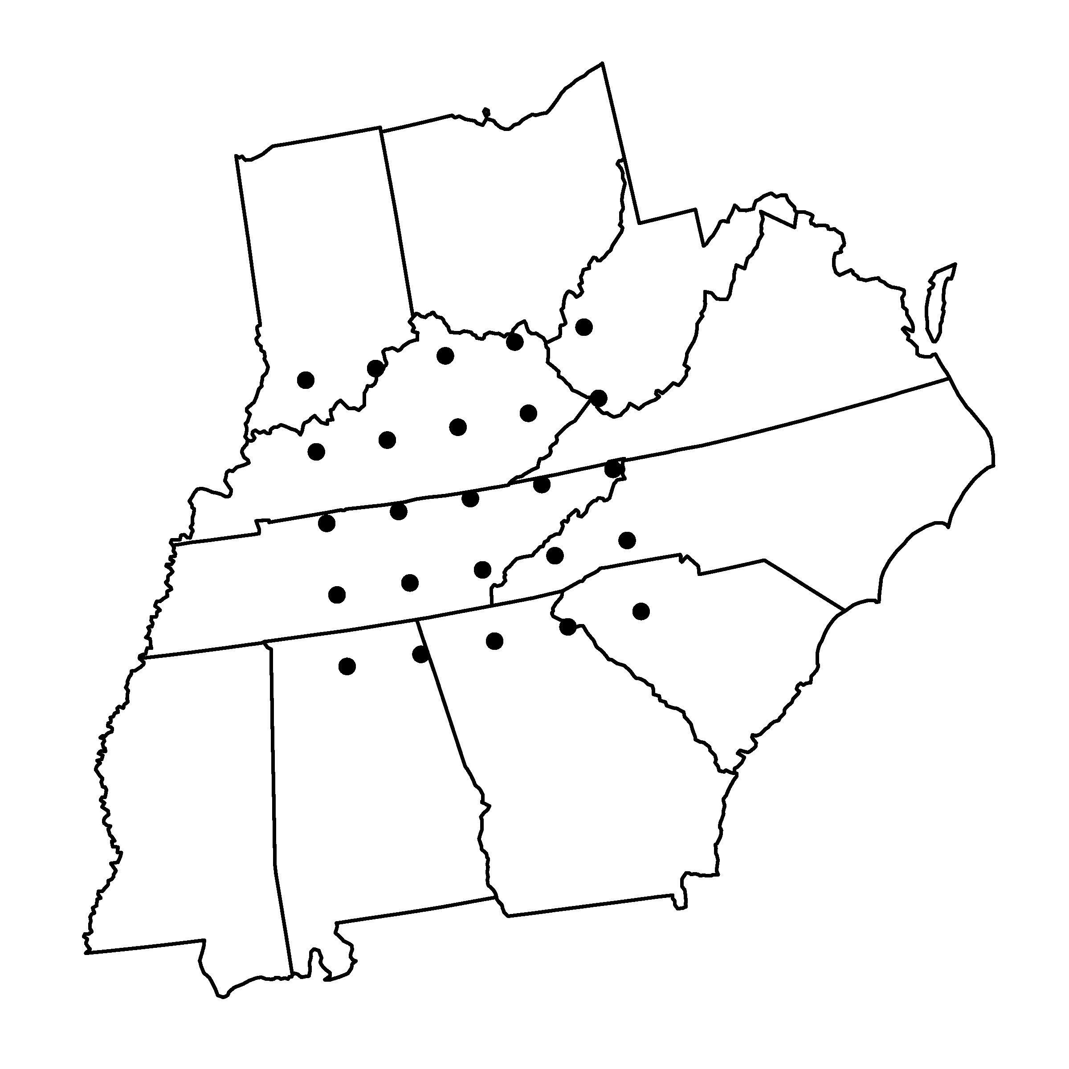
Locations
I’m calling them SW and SE, though that is not entirely correct.
Distances between grid points are somewhere in the range of 1-6 degrees

Slide 3
Wasserstein distance
 | Southwest | Southeast
Temp | 0.304 (0.035) | 0.139 (0.03)
Prcp | 0.027 (0.009) | 0.052 (0.007)
Mean (SD) of Wasserstein distance across the 25 locations in each region
Each value is computed based on all 12 months of data
Values at individual grid cells on next slide
Additional measure – RMSE of cross-correlations:
  SW: 0.0002
  SE: 0.0001

Slide 4
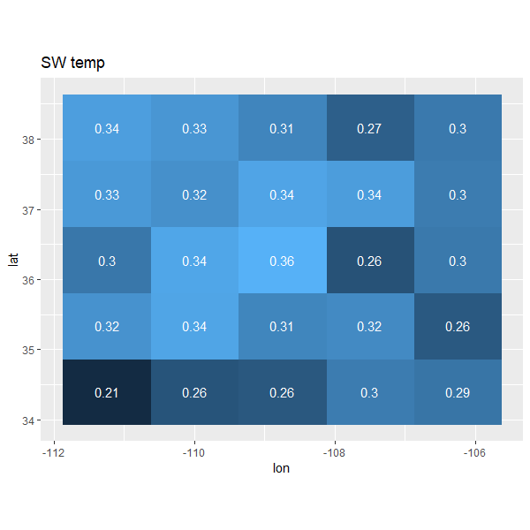
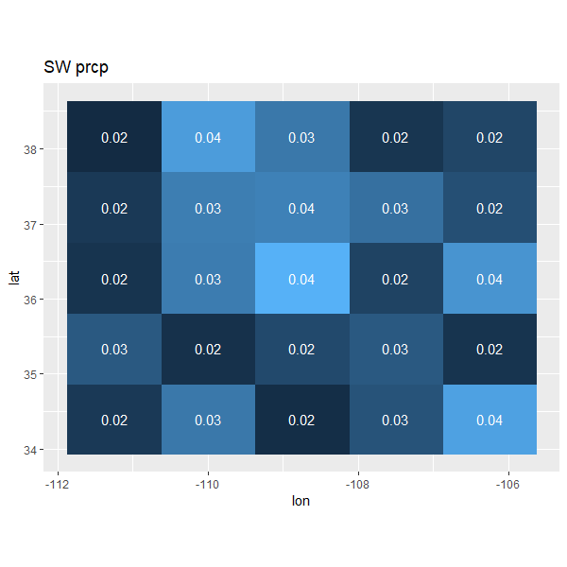
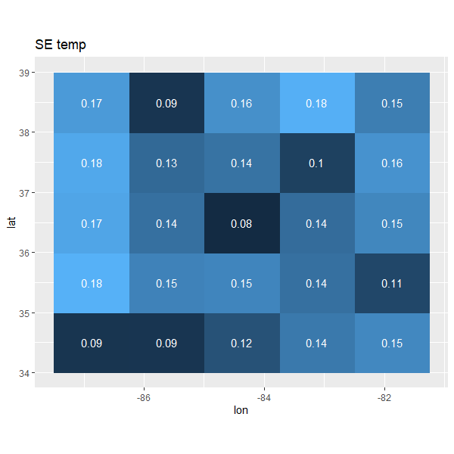
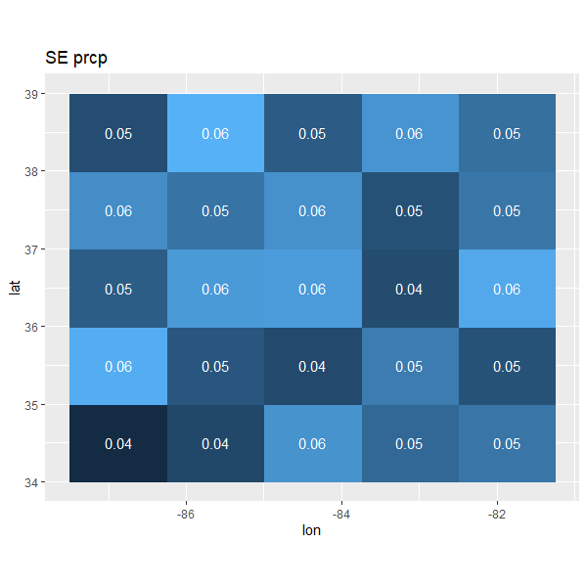

Slide 5
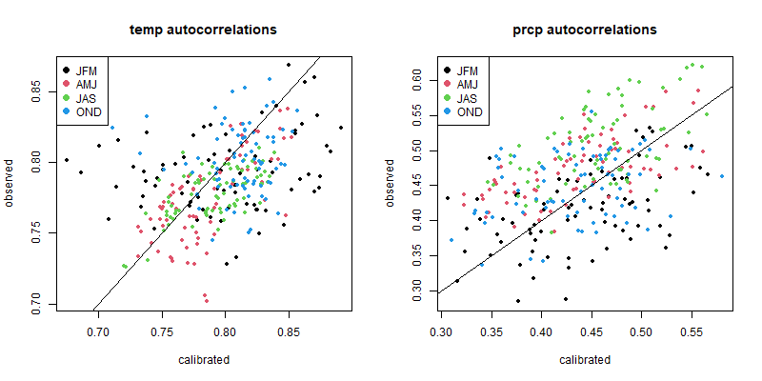
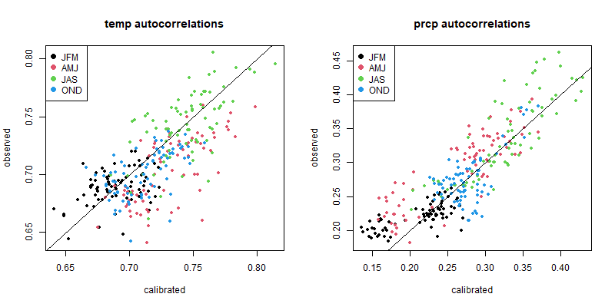
Autocorrelations at each grid cell and each month (25 x 12 values)
SW on top, SE in the bottom
SE has less variability, but low prcp has more bias
I don’t have the autocorrelations for the GCM data saved, but I can overlay those

Slide 6
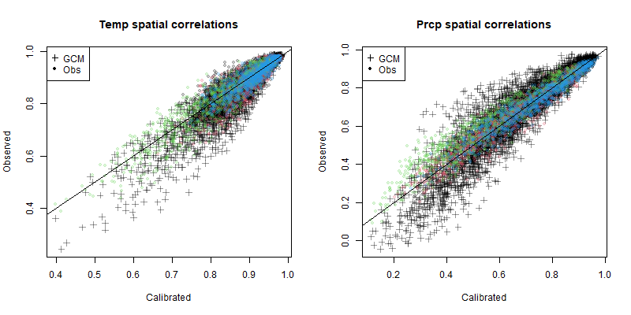
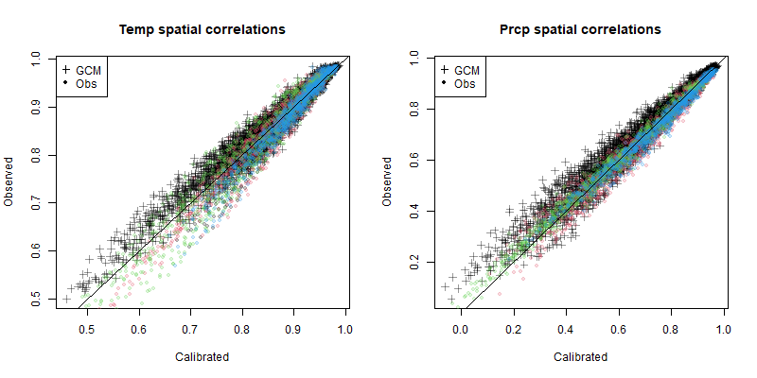
Spatial correlations at each grid cell pair and each month (300 x 12 values)
SW on top, SE in the bottom
GCM spatial correlations overlaid
SE has less variability
Low values have more variability in all plots

Slide 7
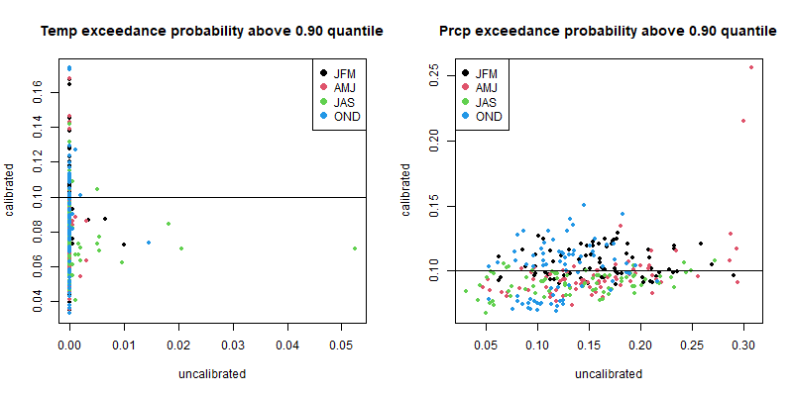
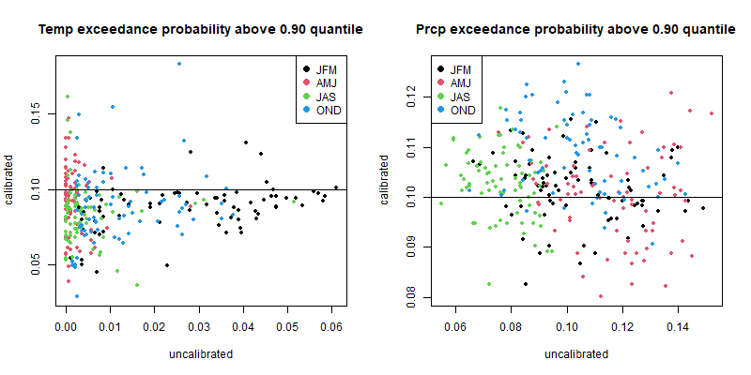
Exceedance probabilities at each grid cell and each month (25 x 12 values)
SW on top, SE in the bottom
True value always 0.10 in this case
Temp interpretation:
  GCM data for SW has very thin upper tails (x-axis)
  SE also, but better than SW
  Ranges seem roughly the same after calibration (y-axis)
Prcp interpretation:
  SW had a LOT more variability in its upper tail mass than SE (values ~0.30)
  For SE, GCM actually lines up decently
  After calibration, both SE and SW have similar ranges (except some SW outliers)

